Slide 1
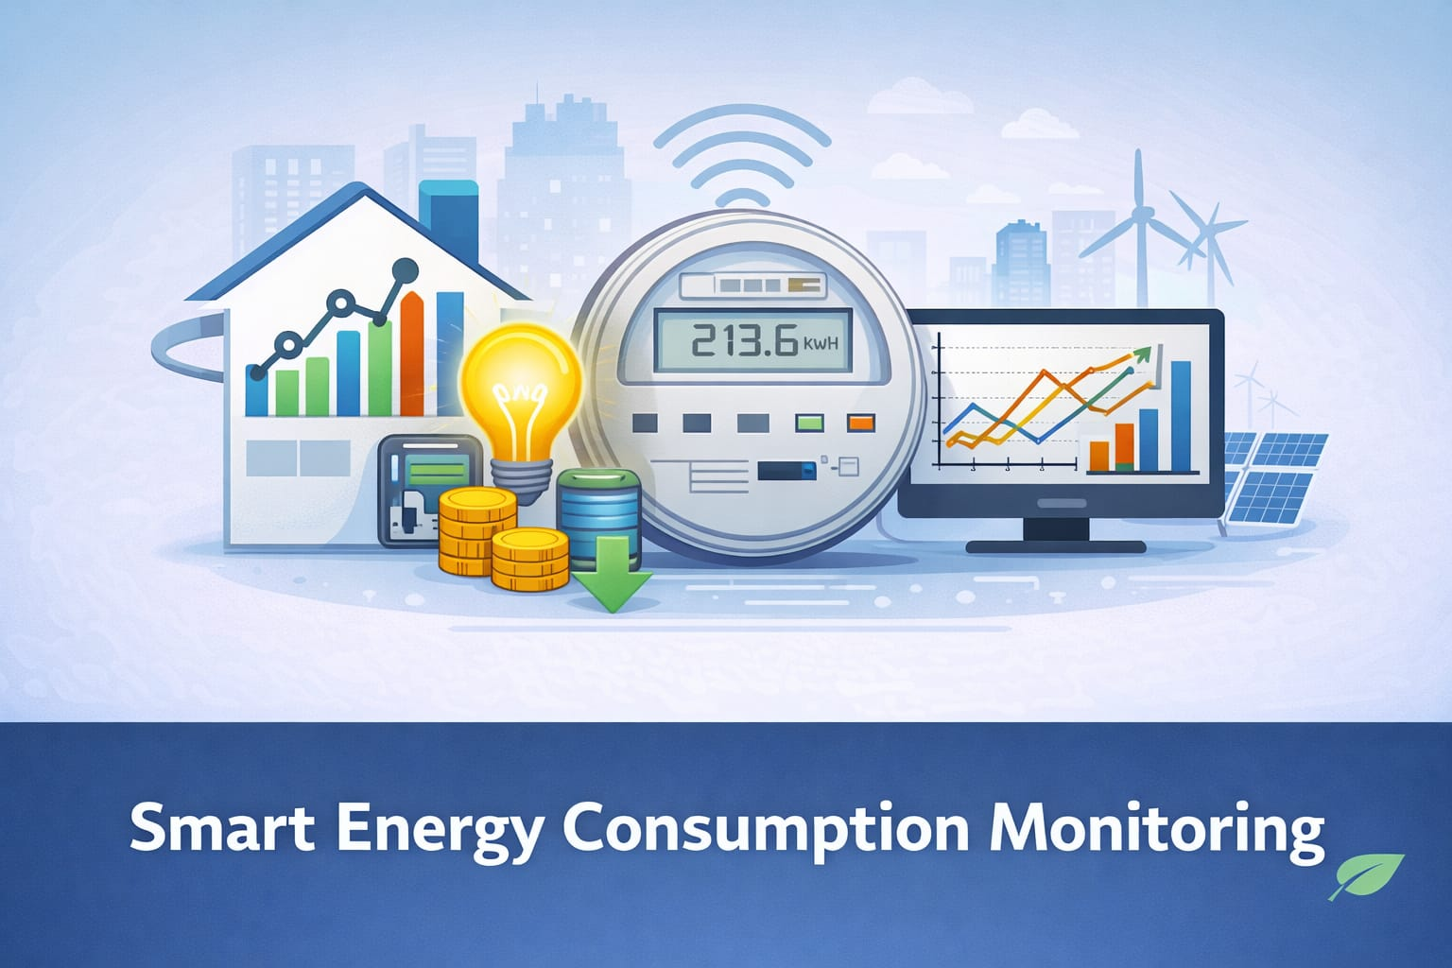
SMART EMNERGY CONSUMPTION ANALYSIS AND PREDICTION USING MACHINE LEARNING

Slide 2
Technology Stack
2. Data Processing & Analysis
Pandas – For dataset cleaning and preprocessing
NumPy – For numerical calculations
1.Programming Language
Python- Core language used for:
Data processing
Machine learning
Backend development

Slide 3
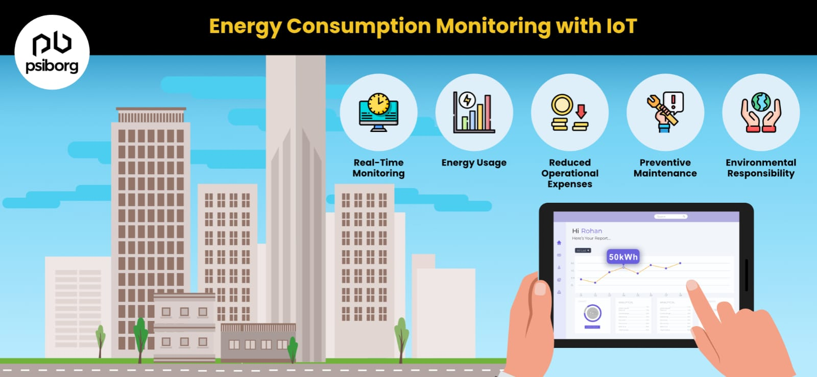
CORE FUNCTIONS of smart energy consumption
Alert System- peak load optimization
Anomaly Detection
Recommendations
Device level Energy organization
Graphical representation

Slide 4
DISADVANTAGES OF EXISTING SYSTEM
No real-time monitoring of electricity usage
Manual meter readings lead to human errors
Users are unaware of where energy is wasted
No prediction of future energy consumption
High electricity bills due to inefficient usage
Lack of automation in power management
Difficult to identify faulty or over-consuming appliances
Delayed feedback on energy usage patterns

Slide 5
SYSTEM ARCHITECTURE
User Interface
Allows users to log in and select the time period for energy analysis
Data Collection Module
Collects energy consumption data from users, sensors, or stored datasets
Data Preprocessing Module
Cleans and formats raw data by handling missing values and noise
Machine Learning Module
Trains models using historical data to predict future energy consumption

Slide 6
MEASURABLE OUTCOMES
Accurate monitoring of daily, monthly, and yearly energy usage
Prediction of future electricity consumption
Early alerts for overconsumption
Visualization of energy usage through graphs and reports
Energy-saving recommendations for users
Improved awareness of energy consumption patterns
Reduced electricity wastage and cost
Sustainable and eco-friendly energy management
Unified access via website and mobile application

Slide 7
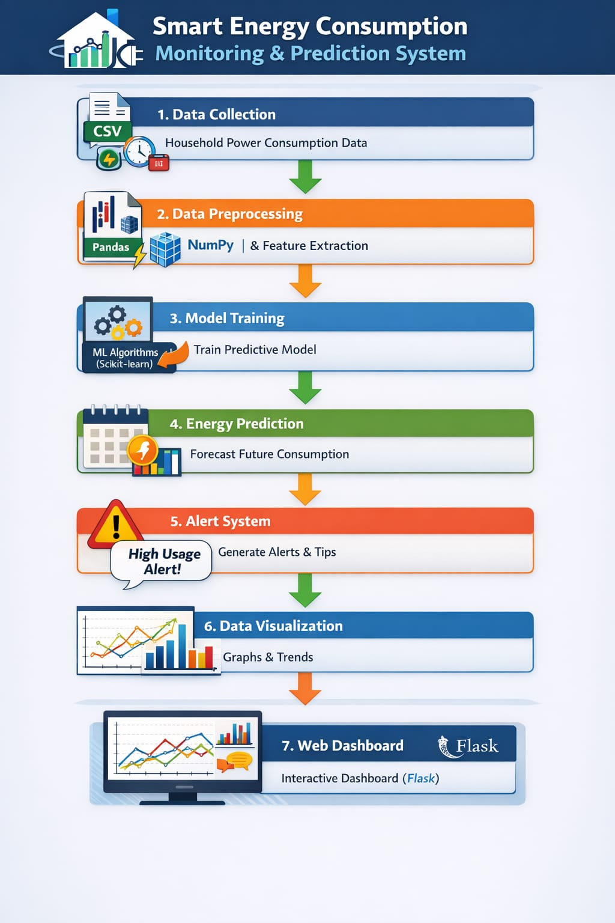
WORKING PROCESS OF OUR PROJECT
Our system first collects and preprocesses energy consumption data. Then we extract useful features and train a machine learning model using Scikit-learn. The model predicts future energy usage. If the predicted value exceeds a threshold, the system generates alerts and recommendations. Finally, the results are displayed on a Flask-based web dashboard with visualizations.

Slide 8
THANK YOU

